Slide 1
TITLE

Slide 2
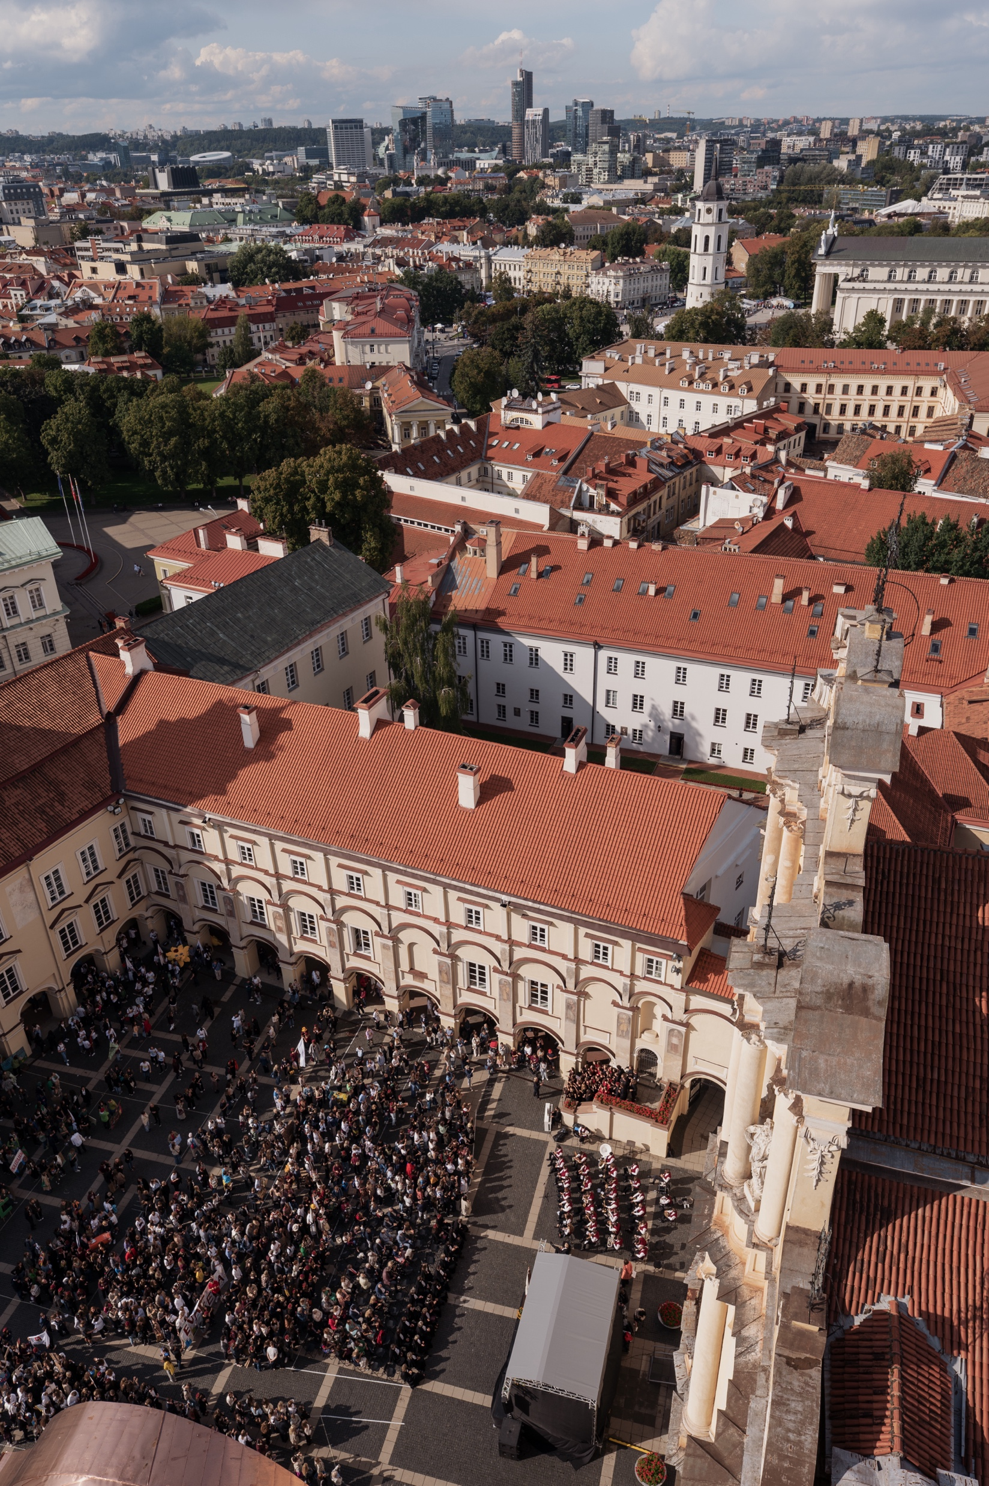

Slide 4


Slide 5


Slide 7


Slide 8
SECTION TITLE

Slide 11


Slide 15


Slide 17
Chart

Slide 18
Chart

Slide 19
Chart II

Slide 20
Chart II

Slide 22
Chart III

Slide 24
CONTACTS

